Slide 1
PowerShell, CSV files and SQL Server: My Journey to over 200,000 rows/sec
Chrissy LeMaire, PowerShell MVP
* Deck optimized for redistribution. Please see notes.
Notes:
This slide deck is intended to be as useful as possible, even if you were not at the session. Most slides have a comprehensive notes section.
If the fonts do not install automatically for you, please take the time to download it or the deck will be distractingly ugly. The Ubuntu font is free and is used within all PsConf.eu slide decks. The Font Awesome font is also free (and awesome.)
http://font.ubuntu.com/
https://fortawesome.github.io/Font-Awesome/
Enjoy!

Slide 2
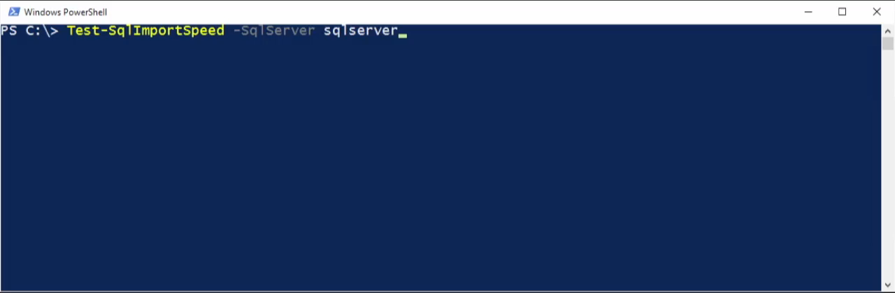
-WhatIf
Notes:
What if by the time you were finished reading this sentence, PowerShell could import 1 million rows of real-world data to SQL Server?
That would be awesome!

Slide 3
Agenda
The Journey (with code)
Notes:
Just kidding.. there’s also 5 bonus tips and a summary.

Slide 4



Where it all began
!!!
9 million rows
geonames.csv
A coworker came in and asked if I could import a 9 million row CSV file filled with geo data. As I considered my SQL options,
he mentioned using Java to split the file into 4 and then parsing it out that way. I was like “Oh, wait! I can do it in PowerShell!
You ever used it? I bet there’s some command that goes something like this…..”
Notes:
A coworker came in and asked if I could import a 9 million row CSV file filled with geo data. As I considered my SQL options, he mentioned using Java to split the file into 4 and then parsing it out that way. I was like “Oh, wait! I can do it in PowerShell! You ever used it? I bet there’s some command that goes something like this…..”

Slide 5

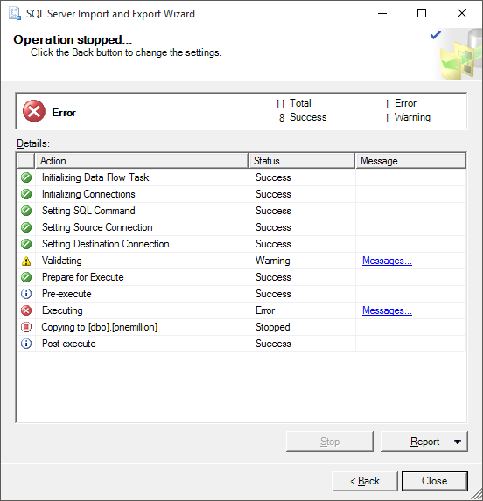
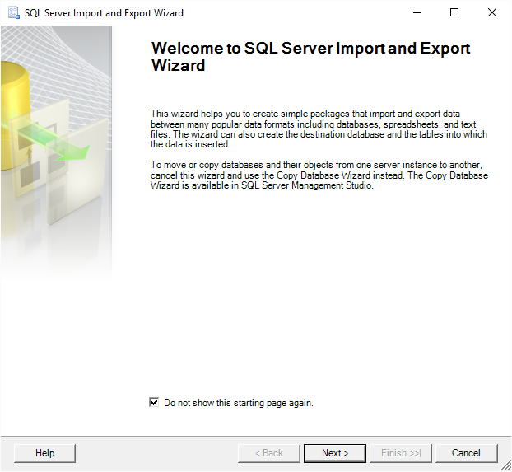
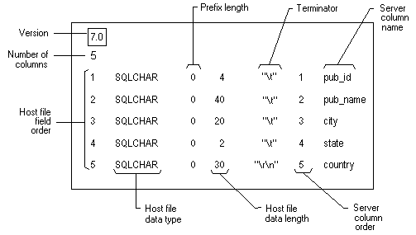
Where it all began
!!!
9 million rows
geonames.csv
Notes:
A coworker came in and asked if I could import a 9 million row CSV file filled with geo data. As I considered my SQL options, he mentioned using Java to split the file into 4 and then parsing it out that way. I was like “Oh, wait! I can do it in PowerShell! You ever used it? I bet there’s some command that goes something like this…..”

Slide 6

Where it all began
Import-Csv –Path $csvfile | Export-SqlServer –Database $db –Table $table
Notes:
Export-* doesn’t exist natively… yet.

Slide 7
Problems with large files & Import-Csv
Memory exhaustion
Suffered a pipeline memory issue prior to PowerShell version 5.0.10586
Collection of objects: 1GB CSV -> 8 GB RAM
Good news! This collection of objects makes it awesome for smaller files
Speed
Microsoft.VisualBasic.FileIO.TextFieldParser 20 seconds
Import-Csv 18 seconds
Lumenworks CSV Reader 7 seconds
Get-Content 5 seconds
System.IO.StreamReader 1 second
Notes:
Import-Csv is awesome for smaller files. I use it all the time.

Slide 8
First, set goals
Pure PowerShell
No bcp.exe
No dtswizard/ SSIS
No hand-crafted T-SQL
BULK INSERT
OPENROWSET
INSERT … SELECT
No third-party assemblies
LumenWorks CSV Reader
No writing to disk
Break world records
* And maybe help fix the speed perception
issues SQLPS has caused
Notes:
No third party requirements for maximum flexibility. I always prefer not to force dependencies on the audience (except SMO when appropriate ;).

Slide 9
Next, just get it working.
SQL Table
Parse the CSV
Perform SQL import
Notes:
Solid plan.

Slide 10
Look @ Code
Setting up the SQL table
Notes:
CREATE TABLE [dbo].[allcountries](
[GeoNameId] nvarchar(255) PRIMARY KEY,
[Name] nvarchar(max),
[AsciiName] nvarchar(max),
[AlternateNames] nvarchar(max),
[Latitude] nvarchar(max),
[Longitude] nvarchar(max),
[FeatureClass] nvarchar(max),
[FeatureCode] nvarchar(max),
[CountryCode] nvarchar(max),
[Cc2] nvarchar(max),
[Admin1Code] nvarchar(max),
[Admin2Code] nvarchar(max),
[Admin3Code] nvarchar(max),
[Admin4Code] nvarchar(max),
[Population] nvarchar(max),
[Elevation] nvarchar(max),
[Dem] nvarchar(max),
[Timezone] nvarchar(max),
[ModificationDate] nvarchar(max)
)

Slide 11
<#
Parsing the CSV
System.IO.StreamReader
Implements a TextReader that reads characters
from a byte stream in a particular encoding.
#>
$reader = New-Object System.IO.StreamReader($csvfile)
while (($line = $reader.ReadLine()) -ne $null)
{
# Do something
}
$reader.Close()
Notes:
https://msdn.microsoft.com/en-us/library/system.io.streamreader

Slide 12
<#
Uploading to SQL Server
System.Data.SqlClient.SqlBulkCopy
Lets you efficiently bulk load a SQL Server
table with data from another source.
#>
$connstring = "Data Source=sqlserver;Integrated Security=true;"
$bulkcopy = New-Object Data.SqlClient.SqlBulkCopy $connstring
$bulkcopy.DestinationTableName = "speedtest"
$bulkcopy.WriteToServer($csvdata)
$bulkcopy.Close()
$bulkcopy.Dispose()
Notes:
https://msdn.microsoft.com/en-us/library/system.data.sqlclient.sqlbulkcopy

Slide 13
The Challenge
$bulkcopy.WriteToServer($csvdata)
$csvdata just can’t be some text
WriteToServer(DbDataReader)
OleDbConnection, SqlDataReader, others
OleDbConnection requires 32-bit PowerShell
SqlDataReader cannot connect to text file
Perhaps EntityDataReader, but probably not
WriteToServer(IDataReader)
Complex but possible, though unlikely
WriteToServer(DataRow[])
Basically requires a DataTable
WriteToServer(DataTable)
DataTables are awesome!
Notes:
$bulkcopy.WriteToServer accepts four types of objects
https://msdn.microsoft.com/en-us/library/system.data.sqlclient.sqlbulkcopy

Slide 14
<#
DataTables
System.Data.DataTable
Represents one table of in-memory data.
#>
$datatable = New-Object System.Data.DataTable
# Add columns
$null = $datatable.Columns.Add("Domain")
$null = $datatable.Columns.Add("Username")
# Create row
$row = $datatable.NewRow()
$row.Item("Domain") = "AD"
$row.Item("Username") = "clemaire"
# Add row to datatable
$null = $datatable.Rows.Add($row)
Notes:
https://msdn.microsoft.com/en-us/library/system.data.datatable
https://blog.netnerds.net/?s=datatable

Slide 15
Problem with large files & DataTables
System.OutOfMemoryException

Slide 16
Look @ Code
Code prone to memory exhaustion
Notes:
<# 2-prone-to-memory-exhaustion.ps1 #>
# MILLION ROW CSV file
$csv = ".\geonames.csv"
$delimiter = "`t"
# Create the Datatable
$datatable = New-Object System.Data.DataTable
# Add columns to the datatable
$null = $datatable.Columns.Add("GeoNameId")
$null = $datatable.Columns.Add("Name")
$null = $datatable.Columns.Add("AsciiName")
$null = $datatable.Columns.Add("AlternateNames")
$null = $datatable.Columns.Add("Latitude")
$null = $datatable.Columns.Add("Longitude")
$null = $datatable.Columns.Add("FeatureClass")
$null = $datatable.Columns.Add("FeatureCode")
$null = $datatable.Columns.Add("CountryCode")
$null = $datatable.Columns.Add("Cc2")
$null = $datatable.Columns.Add("Admin1Code")
$null = $datatable.Columns.Add("Admin2Code")
$null = $datatable.Columns.Add("Admin3Code")
$null = $datatable.Columns.Add("Admin4Code")
$null = $datatable.Columns.Add("Population")
$null = $datatable.Columns.Add("Elevation")
$null = $datatable.Columns.Add("Dem")
$null = $datatable.Columns.Add("Timezone")
$null = $datatable.Columns.Add("ModificationDate")
<#
CREATE TABLE [dbo].[allcountries](
[GeoNameId] nvarchar(255) PRIMARY KEY,
[Name] nvarchar(max),
[AsciiName] nvarchar(max),
[AlternateNames] nvarchar(max),
[Latitude] nvarchar(max),
[Longitude] nvarchar(max),
[FeatureClass] nvarchar(max),
[FeatureCode] nvarchar(max),
[CountryCode] nvarchar(max),
[Cc2] nvarchar(max),
[Admin1Code] nvarchar(max),
[Admin2Code] nvarchar(max),
[Admin3Code] nvarchar(max),
[Admin4Code] nvarchar(max),
[Population] nvarchar(max),
[Elevation] nvarchar(max),
[Dem] nvarchar(max),
[Timezone] nvarchar(max),
[ModificationDate] nvarchar(max)
)
#>
# Open the text file from disk and process.
$reader = New-Object System.IO.StreamReader($csv)
while (($line = $reader.ReadLine()) -ne $null)
{
# EVERYTHING HERE RUNS ONE MILLION TIMES!
# Split line into an array
$data = $line.Split($delimiter)
# Create new row
$row = $datatable.NewRow()
# Populate the row
$row.Item("GeoNameId") = $data[0]
$row.Item("Name") = $data[1]
$row.Item("AsciiName") = $data[2]
$row.Item("AlternateNames") = $data[3]
$row.Item("Latitude") = $data[4]
$row.Item("Longitude") = $data[5]
$row.Item("FeatureClass") = $data[6]
$row.Item("FeatureCode") = $data[7]
$row.Item("CountryCode") = $data[8]
$row.Item("Cc2") = $data[9]
$row.Item("Admin1Code") = $data[10]
$row.Item("Admin2Code") = $data[11]
$row.Item("Admin3Code") = $data[12]
$row.Item("Admin4Code") = $data[13]
$row.Item("Population") = $data[14]
$row.Item("Elevation") = $data[15]
$row.Item("Dem") = $data[16]
$row.Item("Timezone") = $data[17]
$row.Item("ModificationDate") = $data[18]
# Add row to datatable
$datatable.Rows.Add($row)
}
# Close the file
$reader.Close()
# Build the bulk server connection
$connstring = "Data Source=localhost;Integrated Security=true;Initial Catalog=Presentation;"
$bulkcopy = New-Object Data.SqlClient.SqlBulkCopy($connstring)
$bulkCopy.BulkCopyTimeout = 0
$bulkCopy.DestinationTableName = "allcountries"
# Perform the actual insert
$bulkCopy.WriteToServer($datatable)
# Dispose of the datatable
$datatable.Dispose()

Slide 17
How to prevent memory exhaustion?
Notes:
Batch it

Slide 18
# Batch it!
while (($line = $reader.ReadLine()) -ne $null)
{
# Pretend I created the datatable row right here
# It’s a lot of code for one slide
if ($datatable.rows.count % $batchsize -eq 0)
{
$bulkcopy.WriteToServer($datatable)
$datatable.Clear()
}
}
Notes:
“%” or “modding” means divisible, so basically, when $datatable.rows.count is divided by $batchsize, there will be a remainder of 0.

Slide 19
Look @ Code
Code that works
Notes:
<# 3-works.ps1 #>
# Set CSV attributes
$csv = ".\geonames.csv"
$delimiter = "`t"
# Set batchsize to 50000
$batchsize = 50000
# Set connection string
$connstring = "Data Source=localhost;Integrated Security=true;Initial Catalog=Presentation;"
# Stage the bulk server connection
$bulkcopy = New-Object Data.SqlClient.SqlBulkCopy($connstring)
$bulkCopy.BulkCopyTimeout = 0
$bulkCopy.DestinationTableName = "Works"
$bulkCopy.BatchSize = $batchsize
# Create the Datatable
$datatable = New-Object System.Data.DataTable
# Add generic columns instead
$columns = (Get-Content $csv -First 1).Split($delimiter)
foreach ($column in $columns) {
$null = $datatable.Columns.Add()
}
# Start timer
$time = [System.Diagnostics.Stopwatch]::StartNew()
# Open the text file from disk
$reader = New-Object System.IO.StreamReader($csv)
# Process each line
while (($line = $reader.ReadLine()) -ne $null -and ++$i)
{
# Split line into an array
$data = $line.Split($delimiter)
# Create new row
$row = $datatable.NewRow()
# Populate the row
$row.Item("GeoNameId") = $data[0]
$row.Item("Name") = $data[1]
$row.Item("AsciiName") = $data[2]
$row.Item("AlternateNames") = $data[3]
$row.Item("Latitude") = $data[4]
$row.Item("Longitude") = $data[5]
$row.Item("FeatureClass") = $data[6]
$row.Item("FeatureCode") = $data[7]
$row.Item("CountryCode") = $data[8]
$row.Item("Cc2") = $data[9]
$row.Item("Admin1Code") = $data[10]
$row.Item("Admin2Code") = $data[11]
$row.Item("Admin3Code") = $data[12]
$row.Item("Admin4Code") = $data[13]
$row.Item("Population") = $data[14]
$row.Item("Elevation") = $data[15]
$row.Item("Dem") = $data[16]
$row.Item("Timezone") = $data[17]
$row.Item("ModificationDate") = $data[18]
# Add row to datatable
$datatable.Rows.Add($row)
# if the batch size is reached, WriteToServer, then clear datatable
if ($datatable.rows.count % $batchsize -eq 0)
{
# This runs 20 times (1000000/50000)
$bulkCopy.WriteToServer($datatable)
$datatable.Clear()
# Show rows/sec
$rowsec = "{0:N0}" -f [int]$($i / $time.Elapsed.TotalSeconds)
$secs ="{0:N2}" -f $time.Elapsed.TotalSeconds
Write-Output "$i rows written in $secs seconds ($rowsec rows/sec)"
}
}
# Close the file
$reader.Close()
# End timer
$secs = $time.Elapsed.TotalSeconds
# Done! Format output then display
$totalrows = 1000000
$rs = "{0:N0}" -f [int]($totalrows / $secs)
$rm = "{0:N0}" -f [int]($totalrows / $secs * 60)
$mill = "{0:N0}" -f $totalrows
Write-Output "$mill rows imported in $([math]::round($secs,2)) seconds ($rs rows/sec and $rm rows/min)"

Slide 20
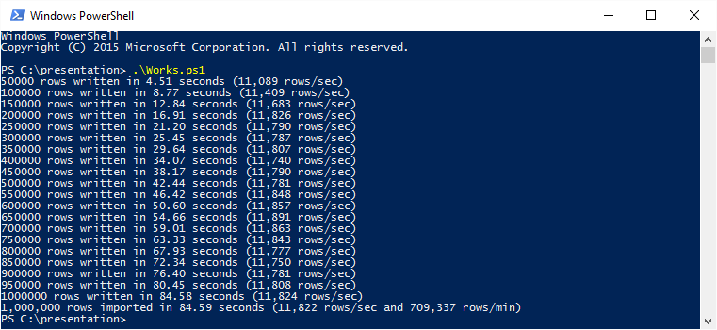
At first..
11,822 rows a second
Nothing to write home about
Notes:
Booooo

Slide 21
# Making it faster
# Fix pain point
while (($line = $reader.ReadLine()) -ne $null)
{
# Now there's enough space!
$null = $datatable.Rows.Add($line.Split($delimiter))
if ($datatable.rows.count % $batchsize -eq 0)
{
$bulkcopy.WriteToServer($datatable)
$datatable.Clear()
}
}
Notes:
Steve Novoselac talked about ItemArray, and this eventually became a one liner.
http://blog.stevienova.com/2008/01/16/net-fastest-way-to-load-text-file-to-sql-sqlbulkcopy/
.Add is far superior to += (See bonus slides for reason why)

Slide 22
Look @ Code
Looking at faster code
Notes:
<# 4-faster.ps1 #>
# Set CSV attributes
$csv = ".\geonames.csv"
$delimiter = "`t"
# Set batchsize to 50000
$batchsize = 50000
# Set connection string
$connstring = "Data Source=localhost;Integrated Security=true;Initial Catalog=Presentation;"
# Stage the bulk server connection
$bulkcopy = New-Object Data.SqlClient.SqlBulkCopy($connstring)
$bulkCopy.BulkCopyTimeout = 0
$bulkCopy.DestinationTableName = "Fast"
$bulkCopy.BatchSize = $batchsize
# Create the Datatable
$datatable = New-Object System.Data.DataTable
# Add generic columns
$columns = (Get-Content $csv -First 1).Split($delimiter)
foreach ($column in $columns) {
$null = $datatable.Columns.Add()
}
# Start timer
$time = [System.Diagnostics.Stopwatch]::StartNew()
# Open the text file from disk
$reader = New-Object System.IO.StreamReader($csv)
# Process each line
while (($line = $reader.ReadLine()) -ne $null -and ++$i)
{
<# First I used ItemArray
$row = $datatable.NewRow()
$row.ItemArray = $line.Split($delimiter)
$datatable.Rows.Add($row)
#>
# Add row in one fell swoop
$null = $datatable.Rows.Add($line.Split($delimiter))
# if the batch size is reached, WriteToServer, then clear datatable
if ($datatable.rows.count % $batchsize -eq 0)
{
# This runs 20 times (1000000/50000)
$bulkCopy.WriteToServer($datatable)
$datatable.Clear()
# Show rows/sec
$rowsec = "{0:N0}" -f [int]$($i / $time.Elapsed.TotalSeconds)
$secs ="{0:N2}" -f $time.Elapsed.TotalSeconds
Write-Output "$i rows written in $secs seconds ($rowsec rows/sec)"
}
}
# Close the file
$reader.Close()
# End timer
$secs = $time.Elapsed.TotalSeconds
# Done! Format output then display
$totalrows = 1000000
$rs = "{0:N0}" -f [int]($totalrows / $secs)
$rm = "{0:N0}" -f [int]($totalrows / $secs * 60)
$mill = "{0:N0}" -f $totalrows
Write-Output "$mill rows imported in $([math]::round($secs,2)) seconds ($rs rows/sec and $rm rows/min)"

Slide 23

This is a little better
35,899 rows a second
308% Increase in speed

Slide 24
Making it faster, SQL edition
Biggest Impacts
Some surprising, some not
Recovery model
Full, Bulk-logged, Simple
Removed Primary Key
Recommended if possible
Pre-allocate data files
Pre-grow your files
Added a TableLock to SqlBulkCopy options
Table locks and multithreaded apps can get along
Reduce SqlBulkCopy Batch Size
Sometimes
Increase Packet Size ('network packet size (B)') on SQL Server and Client
Sometimes
Notes:
Database best practices (such as using full recovery model and primary keys) sometimes slow inserts down.
“Reduce SqlBulkCopy Batch Size”
According to Microsoft, lock escalation kicks in when the batches are more than ~2000 rows. Lock escalation “reduces system overhead while increasing the probability of concurrency contention.” While, 2,000 seems to be the perfect number when performing multithreaded inserts, 50,000-75,000 row batches seem to be the sweet spot for single threaded apps.
“Increase Packet Size”
When multi-threading, I’ve found that increasing the packet size to 32,767 (default is 4096) makes a big difference. I did not see similar results with single-threaded apps.

Slide 25
Look @ Code
Some SQL Changes
Notes:
<# 5-sqlmods.ps1 #>
# Set CSV attributes
$csv = ".\geonames.csv"
$delimiter = "`t"
# Set batchsize
$batchsize = 50000
# Build the bulk server connection
$connstring = "Data Source=localhost;Integrated Security=true;Initial Catalog=PresentationOptimized;"
$bulkcopy = New-Object Data.SqlClient.SqlBulkCopy($connstring,"TableLock")
$bulkCopy.BulkCopyTimeout = 0
$bulkCopy.DestinationTableName = "SQLMods"
$bulkCopy.BatchSize = $batchsize
# Create the datatable
$datatable = New-Object System.Data.DataTable
# Add generic columns
$columns = (Get-Content $csv -First 1).Split($delimiter)
foreach ($column in $columns) {
$null = $datatable.Columns.Add()
}
# Start timer
$time = [System.Diagnostics.Stopwatch]::StartNew()
# Open the text file from disk
$reader = New-Object System.IO.StreamReader($csv)
# Process each line
while (($line = $reader.ReadLine()) -ne $null -and ++$i)
{
# Add row
$null = $datatable.Rows.Add($line.Split($delimiter))
# if the batch size is reached, WriteToServer, then clear datatable
if ($datatable.rows.count % $batchsize -eq 0)
{
$bulkCopy.WriteToServer($datatable)
$datatable.Clear()
$rowsec = "{0:N0}" -f [int]$($i / $time.Elapsed.TotalSeconds)
$secs ="{0:N2}" -f $time.Elapsed.TotalSeconds
Write-Output "$i rows written in $secs seconds ($rowsec rows/sec)"
}
}
# Close the file
$reader.Close()
# End timer
$secs = $time.Elapsed.TotalSeconds
# Done! Format output then display
$totalrows = 1000000
$rs = "{0:N0}" -f [int]($totalrows / $secs)
$rm = "{0:N0}" -f [int]($totalrows / $secs * 60)
$mill = "{0:N0}" -f $totalrows
Write-Output "$mill rows imported in $([math]::round($secs,2)) seconds ($rs rows/sec and $rm rows/min)"

Slide 26
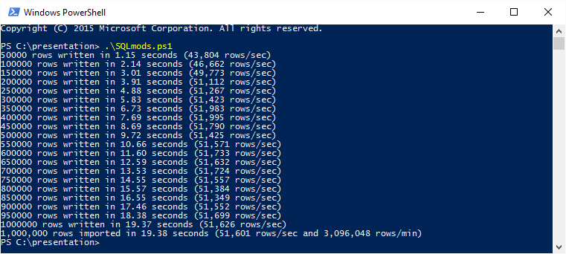
Making it faster, SQL edition
51,601 rows a second
141% increase in speed
436% overall increase increase

Slide 27
Making it faster, SQL edition, cont.
Use Accurate Data Types
Larger datatypes are slower
varchar(5) vs varchar(200)
Varchar(MAX) is crazy slow
150 MB with no varchar(MAX) is faster than 120 MB with one varchar(MAX) column
Notes:
As SQL developers, we’re told about this often, but it was amazing to see it in practice.

Slide 28
Look @ Code
Looking at more accurate SQL code
Notes:
CREATE TABLE Locations (
[GeoNameId] [int],
[Name] [nvarchar](200),
[AsciiName] [nvarchar](200),
[AlternateNames] [nvarchar](max),
[Latitude] [float],
[Longitude] [float],
[FeatureClass] [char](1),
[FeatureCode] [varchar](10),
[CountryCode] [char](2),
[Cc2] [varchar](255),
[Admin1Code] [varchar](20),
[Admin2Code] [varchar](80),
[Admin3Code] [varchar](20),
[Admin4Code] [varchar](20),
[Population] [bigint],
[Elevation] [varchar](255),
[Dem] [int],
[Timezone] [varchar](40),
[ModificationDate] [smalldatetime]
)

Slide 29

Making it faster, SQL edition, cont.
63,295 rows a second
122% increase in speed
535% overall increase
Notes:
The geonames dataset required varchar(MAX), so I changed the dataset to be larger (150MB vs 120MB) customer dataset that allowed for smaller data types.

Slide 30
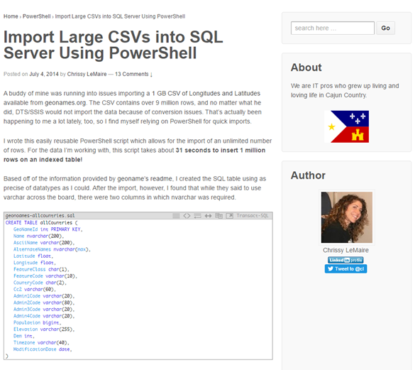
Totally wrote home about it
Notes:
Remember how I said earlier it was nothing to write home about?

Slide 31
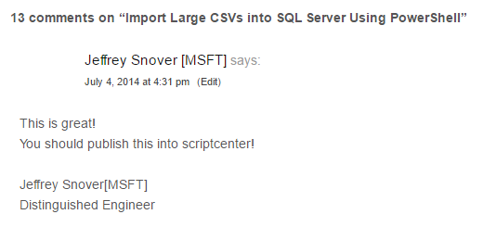

Totally wrote home about it
Notes:
Snover’s looking! Time to do better ;)

Slide 32
Going even faster
90,000 rows/sec
Upgraded client and server to SSD
Changed VM CPU configuration
Removed Write-Output to show progress
Used memory optimized tales in SQL
Notes:
This presentation was originally named “My Journey to 90,000 rows a second”

Slide 33
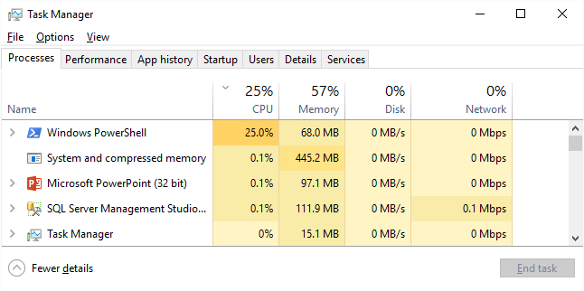
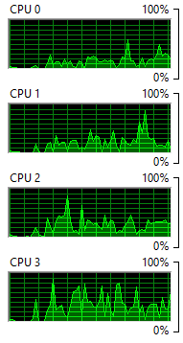
Going even faster
I noticed it only ever hit 25% CPU. By default, PowerShell uses multiple processors, but is not multi-threaded.
Notes:
Noticed it only ever hit 25% CPU. By default, PowerShell uses multiple processors, but is not multi-threaded.
“When using Runspaces, you are creating a new thread on the existing PowerShell.exe host.” ~ Boe Prox

Slide 34
This changes everything
Runspaces
Notes:
Runspaces were initially challenging for me to understand but the payoff has been AMAZING!

Slide 35
Runspaces
Basics
Creating a new thread on the existing PowerShell.exe host
Create and open runspace pool
Create reusable scriptblock (function)
Create runspace and start it
Add to runspace pool
Add runspace to runspaces collection
Wait for runspaces to finish
Clean up
Notes:
I tried my best to get this down to a reasonable number like 3, but it’s impossible. Runspaces were initially challenging for me to understand but the payoff has been AMAZING!
Runspace pools:
Maintain a group of runspaces that have the same characteristics
Can be opened and closed on an as-needed basis
Can be used to execute multiple commands concurrently, with each command invoked in a different runspace.
https://technet.microsoft.com/en-us/system.management.automation.runspaces.runspacepool

Slide 36
Look @ 2 Codes
Runspace concept
Runspace in action
Notes:
<# 6-runspace-concept.ps1 #>
# STEP 1: Create and open runspace pool, setup runspaces array
$pool = [RunspaceFactory]::CreateRunspacePool(1,5)
$pool.ApartmentState = "MTA"
$pool.Open()
$runspaces = @()
# STEP 2: Create reusable scriptblock. This is the workhorse of the runspace. Think of it as a function.
$scriptblock = {
Param (
[string]$connectionString,
[object]$dtbatch,
[int]$batchsize
)
$bulkcopy = New-Object Data.SqlClient.SqlBulkCopy($connectionstring,"TableLock")
$bulkcopy.DestinationTableName = "mytable"
$bulkcopy.BatchSize = $batchsize
$bulkcopy.WriteToServer($dtbatch)
$bulkcopy.Close()
$dtbatch.Clear()
$bulkcopy.Dispose()
$dtbatch.Dispose()
# return whatever you want, or don't.
return $error[0]
}
# STEP 3: Create runspace and add to runspace pool
if ($datatable.rows.count % $batchsize -eq 0) {
$runspace = [PowerShell]::Create()
$null = $runspace.AddScript($scriptblock)
$null = $runspace.AddArgument($datatable.Copy())
$null = $runspace.AddArgument($batchsize)
$runspace.RunspacePool = $pool
# STEP 4: Add runspace to runspaces collection
$runspaces += [PSCustomObject]@{ Pipe = $runspace; Status = $runspace.BeginInvoke() }
$datatable.Clear()
}
# STEP 5: Wait for runspaces to finish
while ($runspaces.Status.IsCompleted -notcontains $true) {}
# STEP 6: Clean up
foreach ($runspace in $runspaces ) {
$results = $runspace.Pipe.EndInvoke($runspace.Status)
$runspace.Pipe.Dispose()
}
$pool.Close()
$pool.Dispose()
# Bonus step 7
# Look at $results to see any errors
<# 7-runspaces.ps1 #>

Slide 37
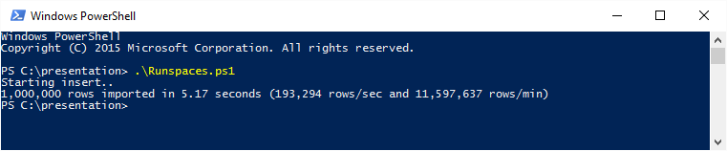
Runspace Performance
193,294 rows a second
305% increase in speed
1634% overall increase
Notes:
Notice there’s no more informational output until the end? There’s a reason for that.
As I mentioned earlier, removing Write-Output sped up the process a great deal.
Before this project, I had no idea that output impacted speed.

Slide 38
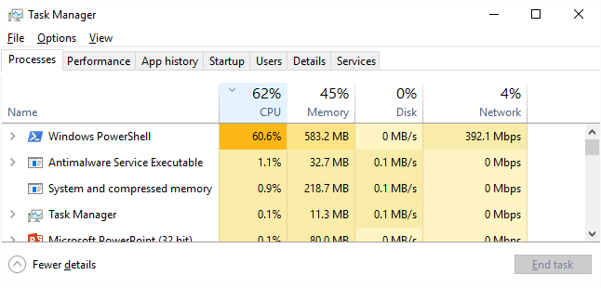
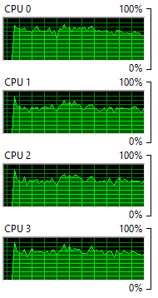
Runspace Performance
Much better!*
Notes:
RAM is still a pain point
Clearing, closing and disposing are extra important when working with massive numbers

Slide 39
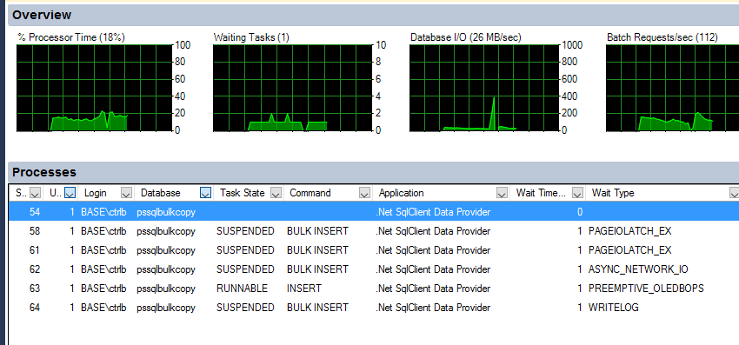
On the SQL Side

Slide 40
Look @ Code
Even faster runspaces
Notes:
<# 8-faster-runspaces.ps1 #>
# Set CSV attributes
$csv = ".\customers.csv"
$delimiter = "`t"
# Set connstring
$connstring = "Data Source=localhost;Integrated Security=true;Initial Catalog=PresentationOptimized;PACKET SIZE=32767;"
# Set batchsize to 2000
$batchsize = 2000
# Create the datatable
$datatable = New-Object System.Data.DataTable
# Add generic columns
$columns = (Get-Content $csv -First 1).Split($delimiter)
foreach ($column in $columns) {
[void]$datatable.Columns.Add()
}
# Setup runspace pool and the scriptblock that runs inside each runspace
$pool = [RunspaceFactory]::CreateRunspacePool(1,5)
$pool.ApartmentState = "MTA"
$pool.Open()
$runspaces = @()
# Setup scriptblock. This is the workhorse. Think of it as a function.
$scriptblock = {
Param (
[string]$connstring,
[object]$dtbatch,
[int]$batchsize
)
$bulkcopy = New-Object Data.SqlClient.SqlBulkCopy($connstring,"TableLock")
$bulkcopy.DestinationTableName = "EfficientRunspaces"
$bulkcopy.BatchSize = $batchsize
$bulkcopy.WriteToServer($dtbatch)
$bulkcopy.Close()
$dtbatch.Clear()
$bulkcopy.Dispose()
$dtbatch.Dispose()
}
# Start timer
$time = [System.Diagnostics.Stopwatch]::StartNew()
# Open the text file from disk and process.
$reader = New-Object System.IO.StreamReader($csv)
Write-Output "Starting insert.."
while ((($line = $reader.ReadLine()) -ne $null))
{
[void]$datatable.Rows.Add($line.Split($delimiter))
if ($datatable.rows.count % $batchsize -eq 0)
{
$runspace = [PowerShell]::Create()
[void]$runspace.AddScript($scriptblock)
[void]$runspace.AddArgument($connstring)
[void]$runspace.AddArgument($datatable) # <-- Send datatable
[void]$runspace.AddArgument($batchsize)
$runspace.RunspacePool = $pool
$runspaces += [PSCustomObject]@{ Pipe = $runspace; Status = $runspace.BeginInvoke() }
# Overwrite object with a shell of itself
$datatable = $datatable.Clone() # <-- Create new datatable object
}
}
# Close the file
$reader.Close()
# Wait for runspaces to complete
while ($runspaces.Status.IsCompleted -notcontains $true) {}
# End timer
$secs = $time.Elapsed.TotalSeconds
# Cleanup runspaces
foreach ($runspace in $runspaces ) {
[void]$runspace.Pipe.EndInvoke($runspace.Status) # EndInvoke method retrieves the results of the asynchronous call
$runspace.Pipe.Dispose()
}
# Cleanup runspace pool
$pool.Close()
$pool.Dispose()
# Cleanup SQL Connections
[System.Data.SqlClient.SqlConnection]::ClearAllPools()
# Done! Format output then display
$totalrows = 1000000
$rs = "{0:N0}" -f [int]($totalrows / $secs)
$rm = "{0:N0}" -f [int]($totalrows / $secs * 60)
$mill = "{0:N0}" -f $totalrows
Write-Output "$mill rows imported in $([math]::round($secs,2)) seconds ($rs rows/sec and $rm rows/min)"

Slide 41
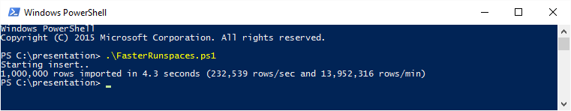
Even faster runspaces
232,539 rows per second
120% increase in speed
1898% overall increase
Notes:
Clearing, closing and disposing are extra important when working with massive numbers
RAM usage is still a pain point
This journey continues….

Slide 42
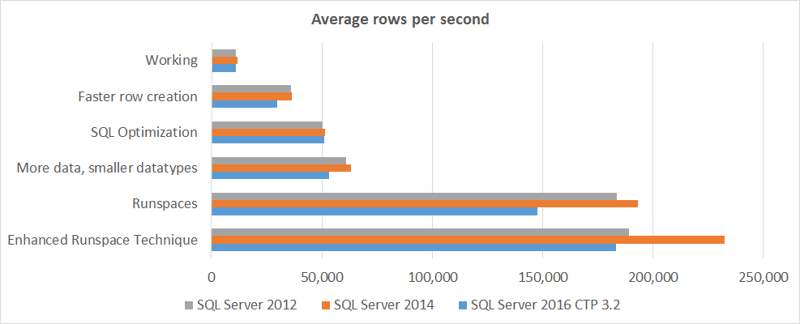
BOOM!

Slide 43
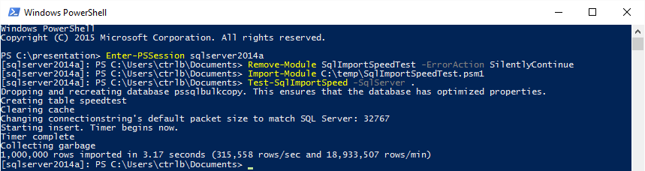
Personal best?
315,558 rows per second!
Notes:
Now this is for a real world dataset. For a two-column dataset, I hit 660,000.

Slide 44
Why is this important?
I am now a better programmer
This changed the way I code
I understand PowerShell & SQL better
People enjoy responsive apps & functions
Solid proof that PowerShell + SQL Server is fast

Slide 45
Bonus Tip: Output slows your scripts
for($i = 0; $i -lt 1000; ++$i) { } 3.7 ms
for($i = 0; $i -lt 1000; ++$i) { $i > $null } 5.2 ms
for($i = 0; $i -lt 1000; ++$i) { Write-Output $i } 29.9 ms
for($i = 0; $i -lt 1000; ++$i) { Write-Progress -Activity $i } 3392.9 ms
Notes:
This is why Invoke-WebRequest’s –OutputFile is *so* slow.

Slide 46
Bonus Tip: Ignoring Output
[void]$(1..1000) 0.21 ms
$null = $(1..1000) 0.21 ms
$(1..1000) > $null 0.67 ms
$(1..1000) | Out-Null 76.21 ms
Notes:
stackoverflow.com/questions/5260125/whats-the-better-cleaner-way-to-ignore-output-in-powershell

Slide 47
Bonus Tip: Adding to Array
$guid = @()
$guid += [guid]::NewGuid().guid x 100,000 43.9 sec
$guid = new-object System.Collections.ArrayList
$guid.Add([guid]::NewGuid().guid) x 100,000 1.7 sec
Notes:
http://foxdeploy.com/2016/03/23/coding-for-speed/

Slide 48
Bonus Tip: Beware of the Pipeline
$all = @('some text' * 20) * 1000000
$all | Out-File file.txt 48 sec
Out-File file.txt -InputObject $all 25 sec
* The pipeline is amazing and crazy useful, but “know when to use it”
Notes:
http://powershell.com/cs/blogs/tobias/archive/2010/11/30/speeding-up-your-scripts.aspx
http://powershell.com/cs/blogs/ebookv2/archive/2012/03/12/chapter-5-the-powershell-pipeline.aspx
Similar in my mind to SQL Server’s set-based thinking as opposed to row-based thinking aka row by agonizing row or RBAR.

Slide 49
Bonus Tips: Where
$files | Where {$_.Name -like "*SQL*"} 13.8 sec
$files | Where-Object Name -like *SQL* 11.3 sec
$files.Where({$_.Name -like "*SQL*"}) 0.7 sec
Notes:
$files = Get-ChildItem C:\ -Recurse
From Jeff Wouter’s presentation “PowerShell Unbound”

Slide 50
This presentation comes with its own module ⬅
SqlImportSpeedTest
Auto downloads CSV datasets
Auto creates databases
Well-documented
Lots of Parameters
Nice example of runspaces
Test-SqlImportSpeed sqlserver2014a
Test-SqlImportSpeed –SqlServer sqlserver2014a –BatchSize 10000 –MaxRunspaces 15 –Dataset VeryLarge
Download: git.io/vuYBB
 VeryLarge.csv 3.6 GB
 Customers.csv 143 MB
 Geonames.csv 122 MB
 SuperSmall.csv 13 MB
Notes:
https://github.com/ctrlbold/modules/tree/master/SqlImportSpeedTest

Slide 51
Or just the presentation code
PowerShell, SQL and CSVs
Or
Just the PowerShell and SQL files
Notes:
If you want the SLN I used

Slide 52
What‘s Next?
Memory optimization / garbage collection
PowerShell Classes with Using
Streaming instead of DataTables
LINQ?
Add-Type with custom iDataReader?
More SQL Server Optimizations
NIC teaming
VM Mods
Microsoft.SqlServer.Dts.Tasks.BulkInsertTask
Natively Compiled Stored Procedure for -MemoryOptimized
Any ideas?

Slide 53
Summary
SQL datatypes matter
PowerShell runspaces are crazy fast
Performance is about more than speed
Better programmer
Better understanding
Changed the way I code

Slide 54
Resources
 SqlImportSpeedTest
⇩ PoshRSJob
 The Art of Runspaces
⬅ Test-NullPerformance
✗ Coding for Speed
 PowerShell Optimization Best Practices
 #PowerShell on Slack
 SQL PASS PowerShell Virtual Chapter
Notes:
https://github.com/ctrlbold/modules/tree/master/SqlImportSpeedTest
https://github.com/proxb/PoshRSJob
https://onedrive.live.com/?id=607A450CAC265331!169&cid=607A450CAC265331 The Art of Runspaces
https://gist.github.com/IISResetMe/610deb873a96f331039d
http://foxdeploy.com/2016/03/23/coding-for-speed/
https://www.youtube.com/playlist?list=PLhj77zH16wHc4dMOq1yJezXUzxaH3XNSc Optimization Best Practices YouTube Playlist
http://slack.poshcode.org/
http://sqlps.io

Slide 55
Next Steps...
Now: 15 min break
Grab a coffee
Stay here to enjoy next presentation
Change track and switch to another room
Ask me questions or meet me in a breakout session room afterwards

Slide 56
Questions?
Notes:
You can hit me up on Twitter, too. @cl

Slide 57
About_Author
SQL Server since 1999 and PowerShell since 2005
System Center Cloud and Datacenter Management MVP since 2015
DBA with General Dynamics IT at NATO Spec Ops HQ in Belgium
@cl on Twitter
Blogs at netnerds.net
Also RealCajunRecipes.com
Lead for the Belgian PowerShell User Group
Co-Lead for SQL PASS PowerShell Virtual Chapter
Please go upvote SQLPS cmdlets at sqlps.io/vote :D
Notes:
Thanks for reading!
Oh, and if you love PowerShell and SQL Server, please help make it better! Microsoft wants to hear your suggestions and opinions. Visit sqlps.io/vote to upvote the cmdlets you want to see in SQLPS.

Slide 58

Test Lab in case you‘re wondering
Shuttle
4 core 3.9 Ghz i7
32 GB RAM
512 GB Local SSD
1 Gbit NIC
AirPort Extreme
1 Gbit Wired
Notes:
In case you’re wondering
All of this is local storage
Average 229,450 rows/sec

Slide 59
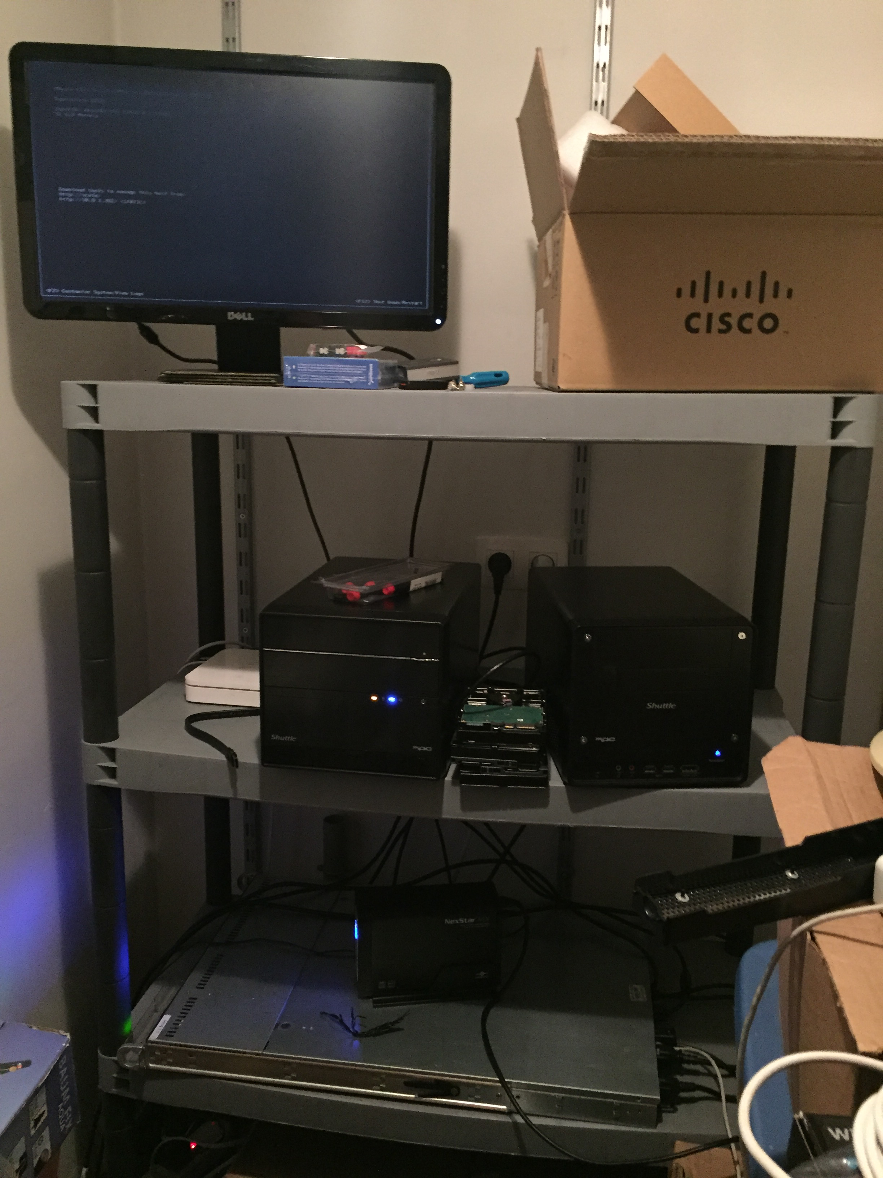
Actual Test Lab
LOL :/
Notes:
LOL :/

